Slide 1
Domain adaptation with regularized optimal transport
Gwangwoo Kim
Jun. 16, 2023

Slide 2
Domain Adaptation (DA)
Usually, the training data Xs and the test data Xt are generated from the same distributions.
But real life data often exhibit different behaviors.

Slide 3



The Monge-Kantorovitch problem
The original Monge transportation problem
The Kantorovitch formulation
The Wasserstein distance

Slide 4



Example: discrete distributions
Given the two distributions
The solution should be chosen from
The Kantorovitch formulation is

Slide 5
Example: discrete distributions
Remark 1: If ns = nt = n and all of p’s are 1/n, then the solution will be simply a permutation matrix.
Remark 2: In general, this problem can be solved by linear programming (with combinatorial algorithms)

Slide 6



Regularized optimal transport
Cuturi proposes to regularize the expression of the transport
where
The objective is optimized by using the Sinkhorn-Knopp algorithm.

Slide 7
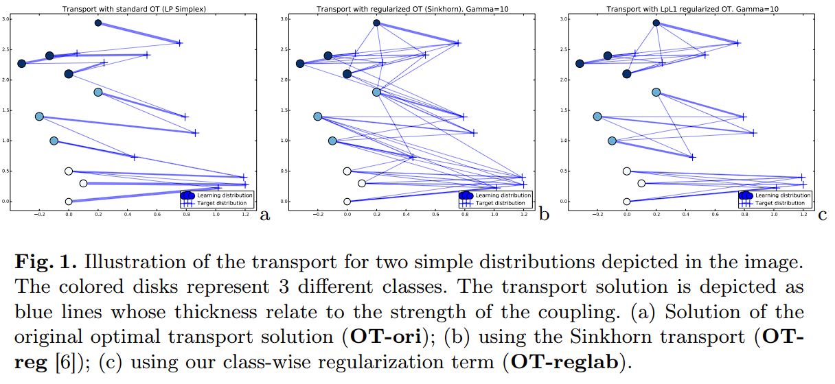
DA with OT

Slide 8
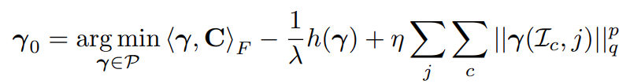
Principles of the label regularization
Note that p=1 and q=2 lead to the classical group-lasso
Suggestion: p=1/2 and q=1

Slide 9



Interpolation of the source domain
Interpolation objective:
Solution:
Or compute directly the image of the source

Slide 10
Interpolation of the source domain
Interpolation objective:
Solution:
Or compute directly the image of the source

Slide 11
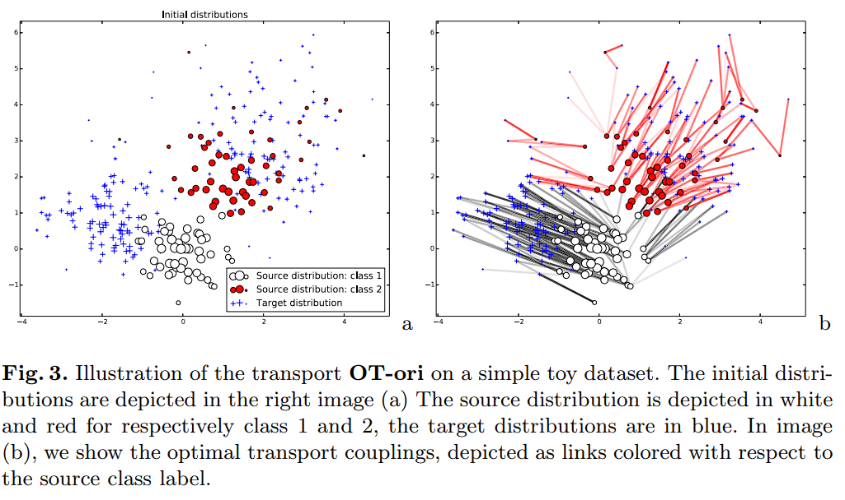
Toy Dataset

Slide 12
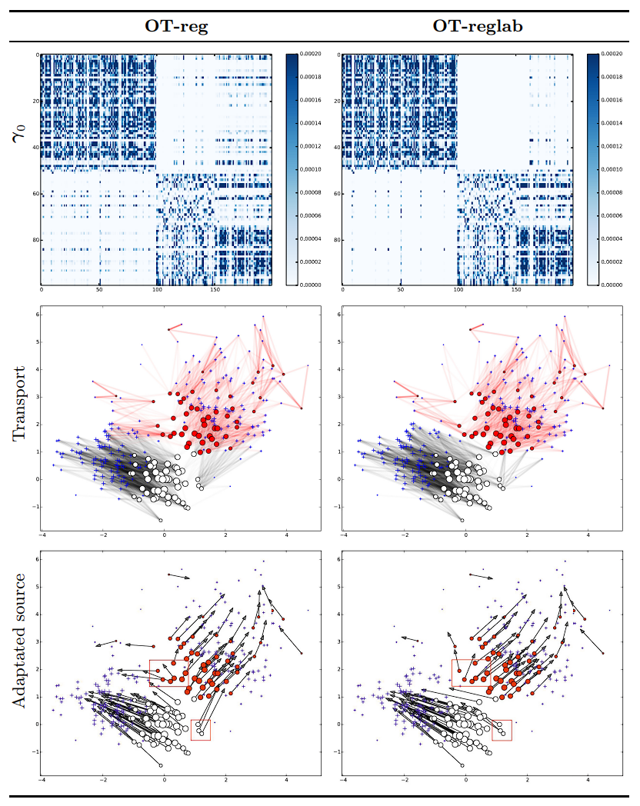
Toy Dataset

Slide 13
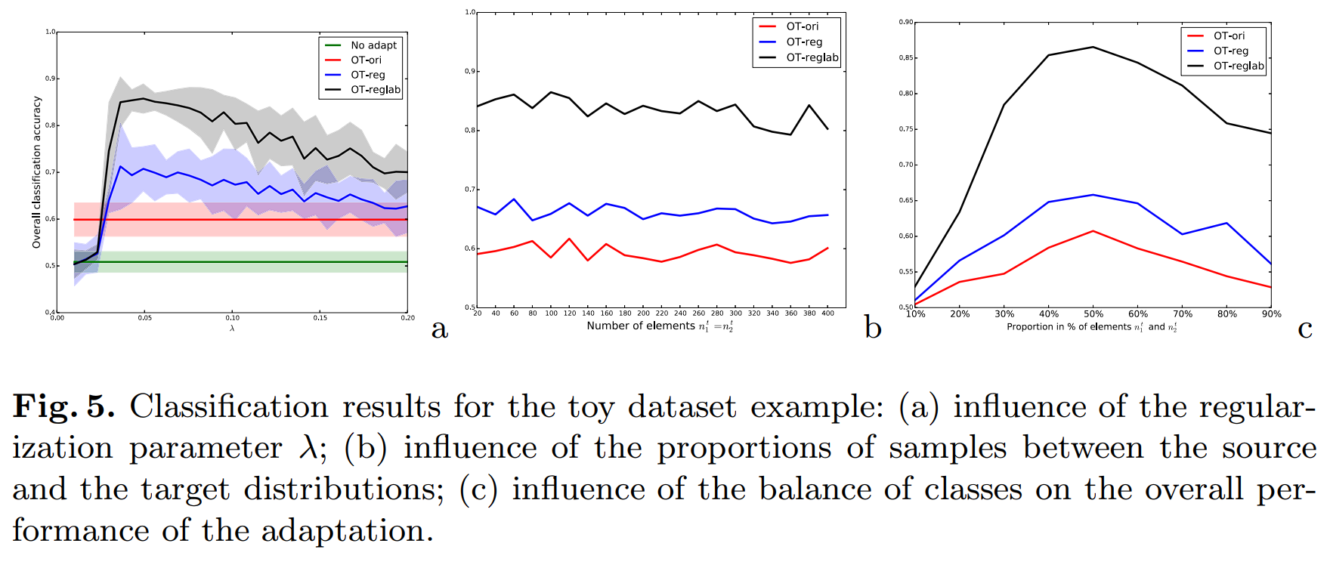
Classification study

Slide 14
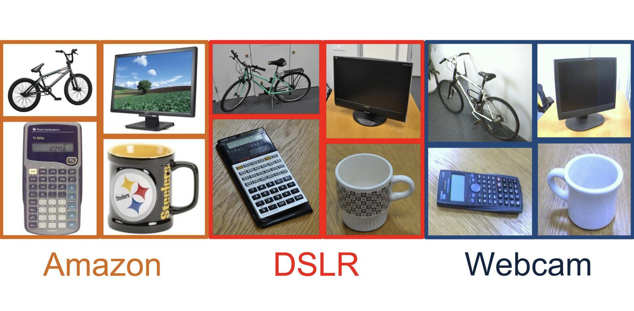
Classification study 2
Koniusz, P., Tas, Y., & Porikli, F. (2017). Domain adaptation by mixture of alignments of second-or higher-order scatter tensors. In Proceedings of the IEEE conference on computer vision and pattern recognition (pp. 4478-4487).

Slide 15
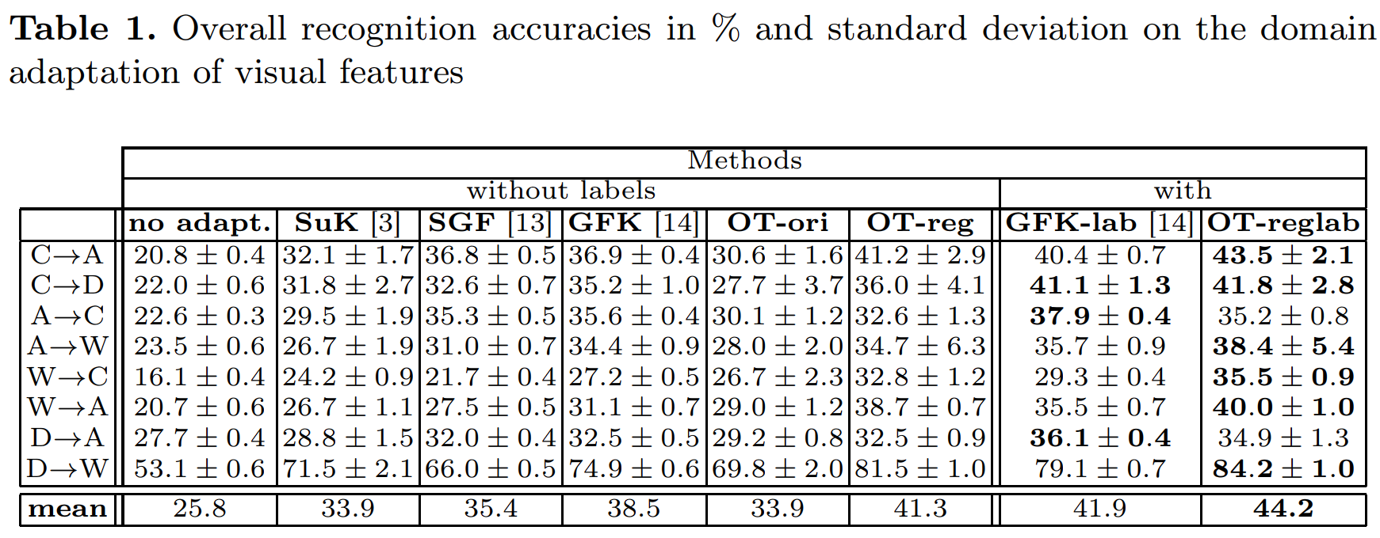
Classification study 2

Slide 16
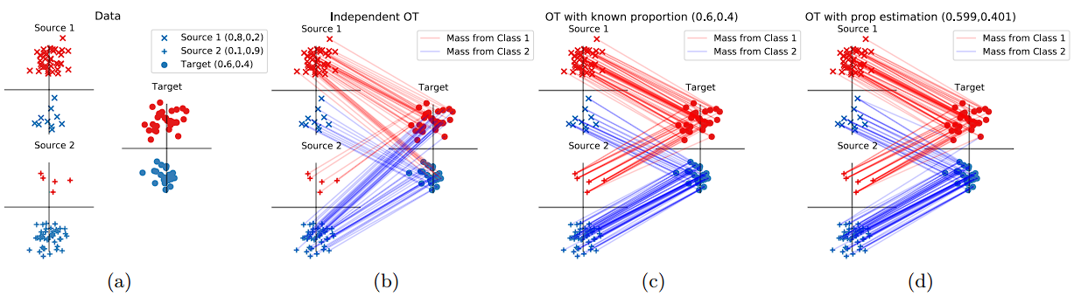
Next

